Slide 1

Data Analyst Case Study
Sales Prediction and Order Suggestion Comparison between Model A and Model B

Slide 2
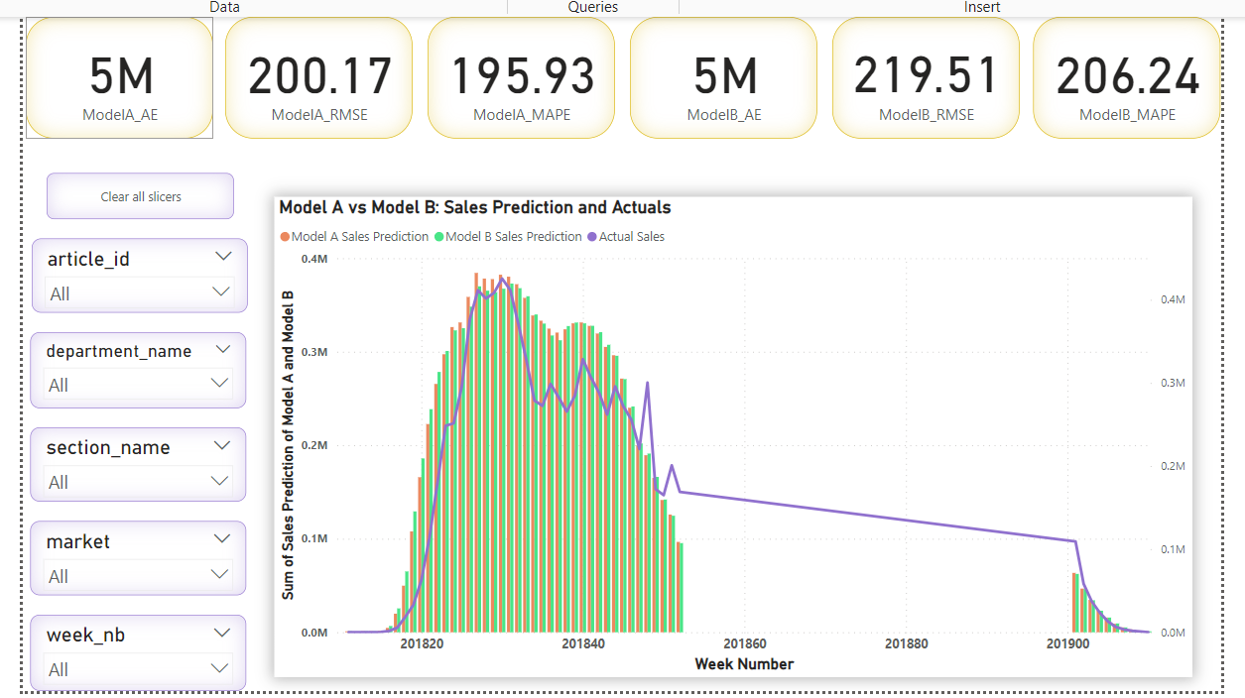
Part 1:Sales Prediction Model Comparison
Metrics analyzed: Absolute Error, RMSE, MAPE.
Weekly sales prediction vs actuals for Model A and Model B
Sales Prediction and Error Metrics

Slide 3
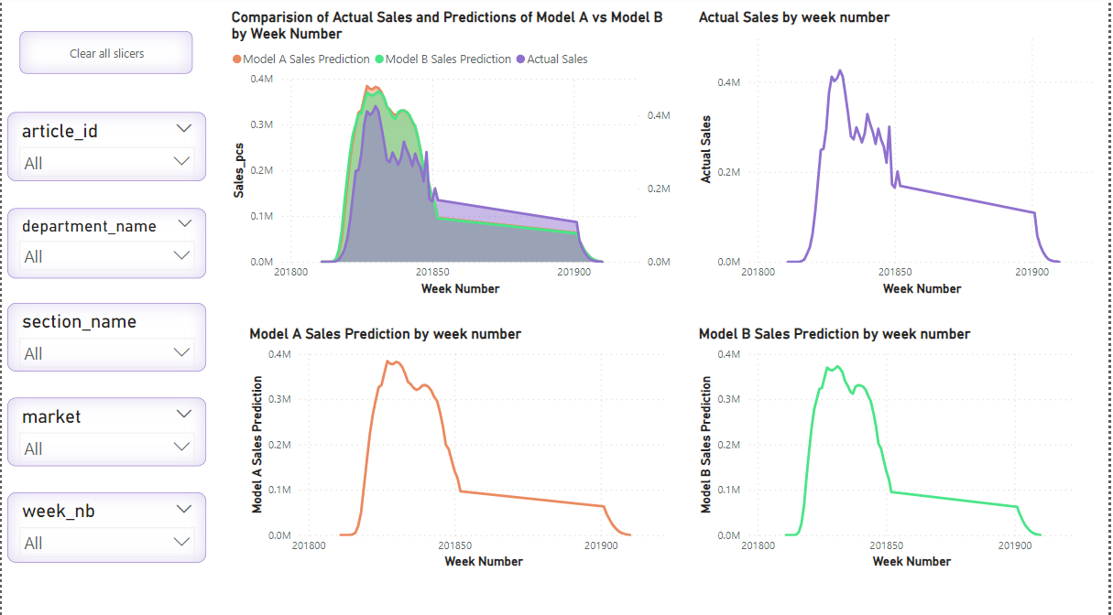
Sales Predictions vs. Actual Sales by Week
Area chart for actual sales and predictions of Model A and Model B.
Line charts showing week-wise trends for actual and predicted sales.

Slide 4
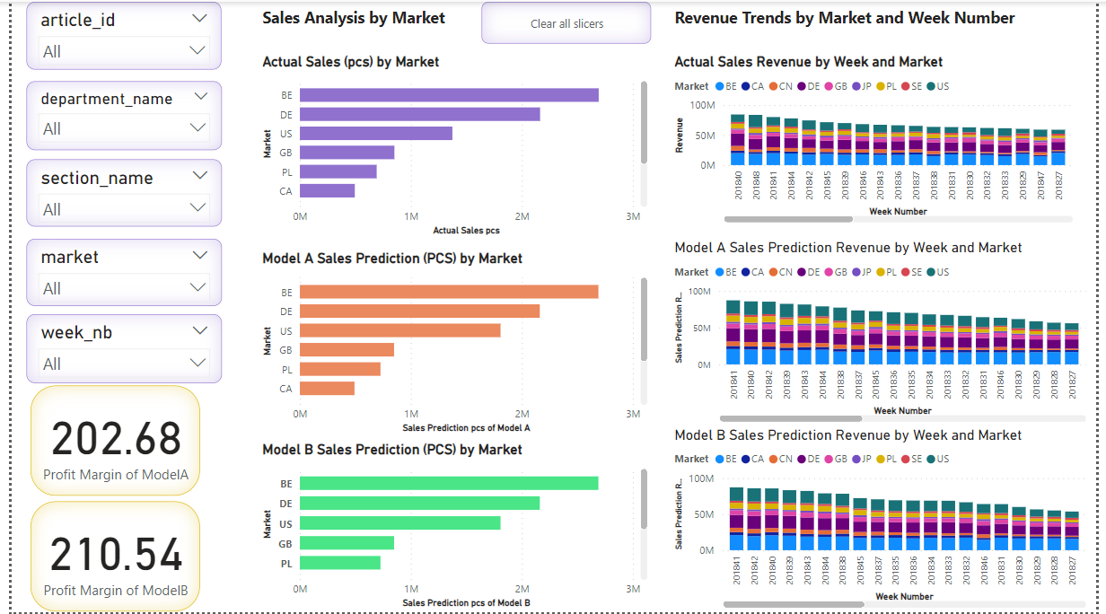
Profit margin analysis for both models.
Weekly and market trends for revenue and sales .

Slide 5
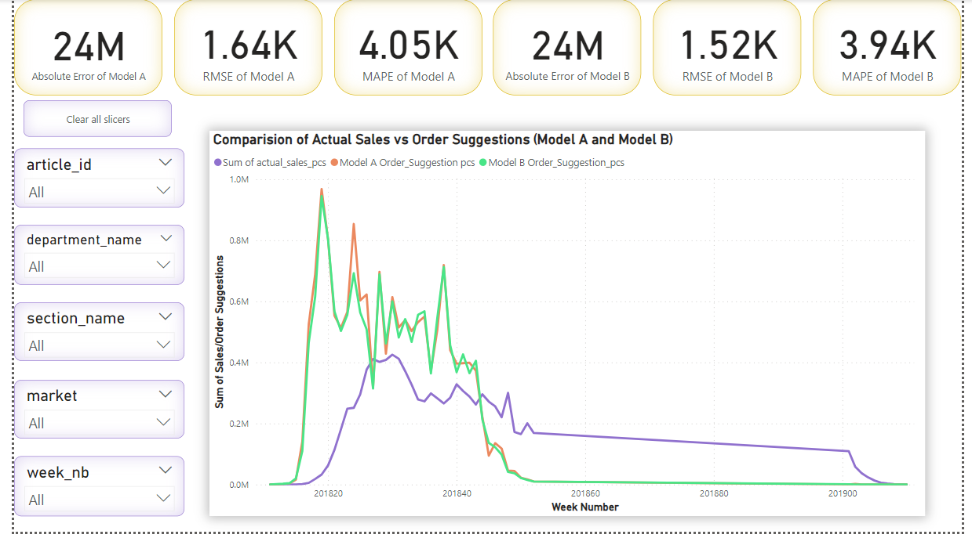
Part 2: Order Suggestion and Stock Analysis
Absolute Error, RMSE, and MAPE metrics for Model A and Model B.
Line chart comparing actual sales and order suggestions.

Slide 6
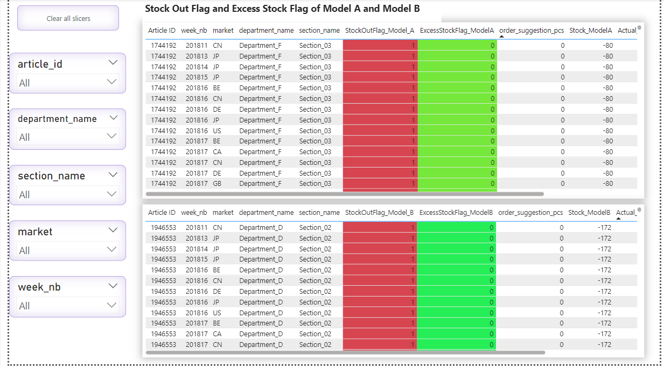
Two tables for Model A and Model B with detailed columns: Article ID, Week Number, Market, Department Name, Section Name, Stock Out Flag, Excess Stock Flag, Order Suggestion_PCS, Actual Sales, Sales Prediction, and Stock.
Conditional formatting (Green = 0, Red = 1) for stock flags.
Excess Stock Flag =
IF([Stock_Model] > 5000, 1, 0)
StockOutFlag=
IF([Stock_Model] < 0, 1, 0)
Stock for a specific week = Stock from last week + order levels for current week - sales for current week

Slide 7
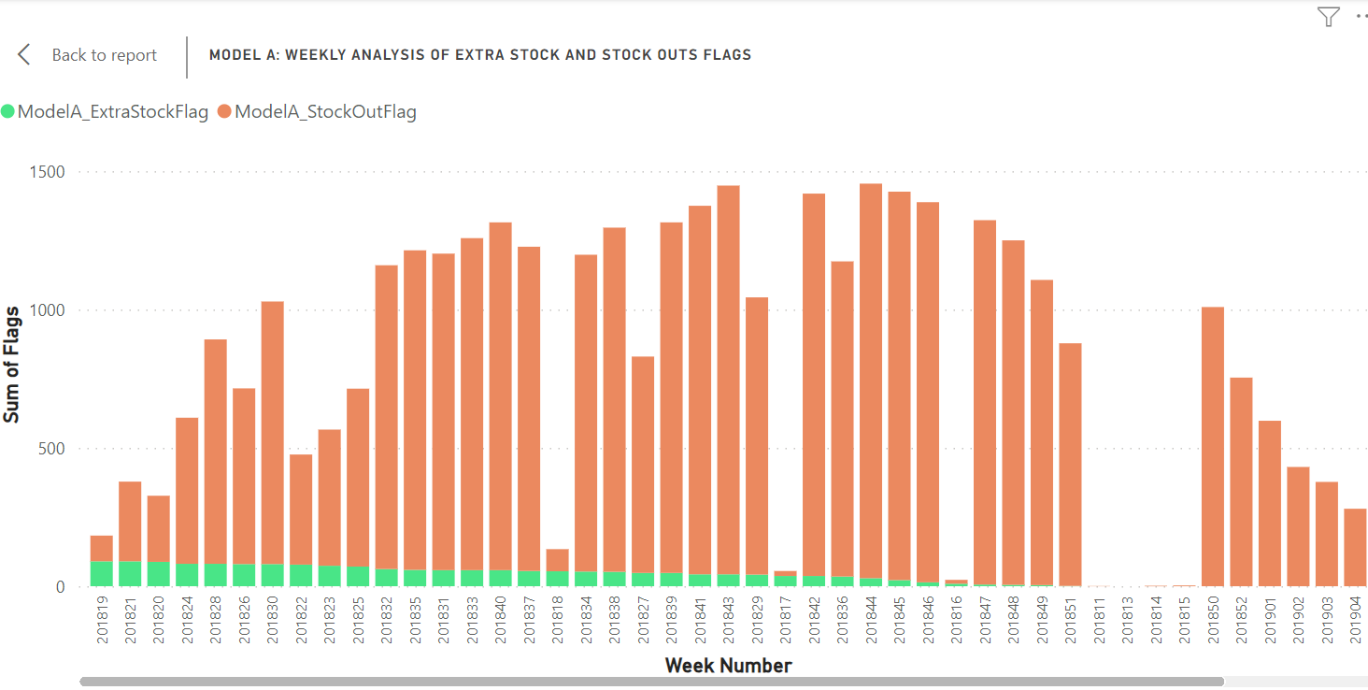
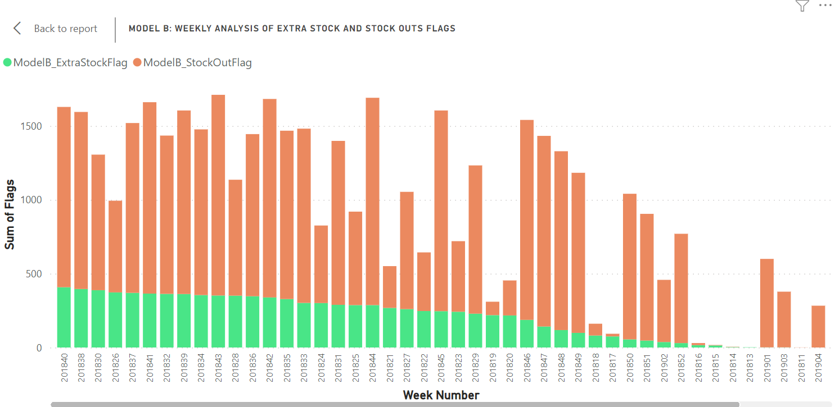
Weekly Stock Flags Analysis
Stacked column charts showing weekly trends for extra stock and stock out flags for Model A and Model B.

Slide 8
Summary of Model A vs Model B performance for sales prediction and order suggestion.
Key Insights: Part-1
Error Metrics Comparison:
Model A: Absolute Error = 5M, RMSE = 200.17, MAPE = 195.93.
Model B: Absolute Error = 5M, RMSE = 219.51, MAPE = 206.24.
Closer Prediction to Actual Sales:
While Model A has lower error metrics overall, Model B’s predictions are closer to actual sales based
on the visual trends in sales prediction and weekly analysis charts.
Weekly Sales Analysis:
Both the area chart and weekly trend analysis indicate that Model B aligns
better with actual sales trends compared to Model A.
Profit Margin:
Model A: 202.68
Model B: 210.54
Model B achieves a slightly higher profit margin despite higher error metrics.
Revenue and Market Trends:
By slicing data across week numbers and markets, Model B consistently demonstrates closer
alignment with actual sales and performs slightly better in revenue analysis.

Slide 9
Key Insights: Order Suggestion Analysis (Part 2)
Error Metrics Comparison:
Model A: Absolute Error = 24M, RMSE = 1.64k, MAPE = 4.05k.
Model B: Absolute Error = 24M, RMSE = 1.52k, MAPE = 3.94k.
Model B has slightly better error metrics than Model A.
Closer Alignment with Actual Sales:
In the comparison of actual sales vs. order suggestions, Model B’s suggestions are closer to actual sales, as shown in the line chart.
Stock Analysis:
Model A:
Excess Stock Flag = 1,745
Stock Out Flag = 36k
Higher stock out flags, lower excess stock flags.
Model B:
Excess Stock Flag = 9,399
Stock Out Flag = 35k
Higher excess stock flags, slightly lower stock out flags.
Weekly Trends:
Model A shows higher stock out flags compared to excess stock flags.
Model B has both higher stock out and excess stock flags, but excess stock is significantly higher than in Model A.

Slide 10
Conclusion:
Part 1: Model B remains the stronger model for sales prediction, as seen through trend analysis, even with minor error matrix variations and shows closer alignment with actual sales and profit margin
Part 2 Model B remains the stronger model in order suggestion seen through trend analysis, Model B performs better in stock predictions, despite slight differences.

Slide 11
Thank You
By
TG Nithya

